Slide 1





Vehicle Collateral Loans on Blockchain

Slide 2



Objective
Making Collateral loan system transparent and available for all.
Making it automated removing all manual errors.
Directly passing benefits to user instead of third-party mediators.
Improving user experience for easy adaptability.

Slide 3
Current Process
Borrower goes to bank requesting a loan.
Bank assign’s the agent and a list of documents.
The document are the collected, verified and validated which usually takes a lot of time.
Then another agent is assigned for vehicle inspection
Then the loan amount and terms are decided by the bank and forwarded to the borrower.
Then the borrower agrees or disagrees on terms and respectively the amount is disbursed.

Slide 4
Issue with Current Process
Too many middleman are there in the process which leads to –
Less benefits for the user as each have their own cuts (mortality).
Higher chances of manual error (human error).
Too many documentation needed for verification and validation.
User don’t have all available offers at one place.
No transparency in the process (due to middleman).
As so many checks and people are involved the amount of time consumed also increases.

Slide 5








What is Defi ?
Defi (Decentralized Finance) is a financial system built on blockchain technology that operates without intermediaries such as bank or exchanges.
It relies on smart contract to provide transparent, secure and accessible financial services like lending, borrowing, trading and insurance.
Defi has the potential to democratize finance and provide financial inclusion for the unbanked and underbanked.

Slide 6
Why Defi ?
DeFi offers several benefits over traditional finance, such as lower fees, faster transaction times, greater transparency, and increased accessibility.
DeFi is built on a decentralized infrastructure, making it resistant to censorship and fraud. These benefits make DeFi an attractive option for those looking for an alternative to traditional finance.

Slide 7
How can Existing Lending Institutions Participate in DeFi?
By providing liquidity to DeFi protocols, integrating with existing DeFi platforms or creating their own DeFi solutions.
By doing so, they can reach new customers, diversify their revenue streams, and improve their operational efficiency.
However, they must carefully assess the risks and regulatory implications before entering the DeFi space, which is still relatively new and evolving.

Slide 8
Advantages of using Blockchain
Decentralization
Transparency
Security
Efficiency
Innovation
It can increase trust, reduce costs, automate processes, and enable new business models.

Slide 9
Challenges with Blockchain
Scalability
Adoption
Regulation
Interoperability
Security risks

Slide 10
Actors Involved
Lender
Lender can be single entity, a group or an institution
Borrower
Single entity opting for a loan
L
B
RTO
Government entity acting as creator & validator of NFTs
Oracle
For getting off-chain data like creditworthiness, KYC and car market place
R
O

Slide 11
Flow
In a vehicle collateral loan on a blockchain, the borrower applies, and the lender verifies the vehicle ownership and condition.
A smart contract outlines the loan terms, and the borrower receives the loan amount.
The vehicle's ownership is locked on the blockchain as collateral, and the borrower makes repayments.
When the loan is repaid, the smart contract releases the ownership back to the borrower.
The blockchain records and verifies everything for transparency and security.

Slide 12
Background Checks for Debtors
Oracles are used to check the creditworthiness of the debtors.
It contains the KYC details of the borrower and is possible to get a credit rating, if matches it will let the user have access to the portal.
This process is done once while signing up and every time applying for a loan.
These details are available to the lenders to make decision.

Slide 13
Asset Registration and Verification
The physical vehicle is first registered in RTO from the car manufacturer, then it is converted into NFT for the purpose of collateral.
The address of the NFT acts as verification of real asset
Details of the vehicle is added in the network which will be visible for the users
Ownership of the vehicle is transferred only when the borrower completes the payment.

Slide 14
Important Parameters
Incentivization
As there is no middlemen involved in this network the interests/incentives are directly received by the lender according to the terms and conditions agreed between the borrower and lender.
Marketplace
The network will have a marketplace where the list of lenders which can be individual or pools with their conditions stated accordingly. This helps the borrower to look for funds easily at one place.
Risk
Creditors can face risks such as default in payments, borrower not maintaining sufficient balance in the wallet.
Loan Defaults
If the borrower fails to maintain balance in the wallet which the smart contract cannot deduct, he/she will have provided due to pay it with added interest to it. In case of long-term defaults, the ownership of NFT is transferred to the lender.

Slide 15
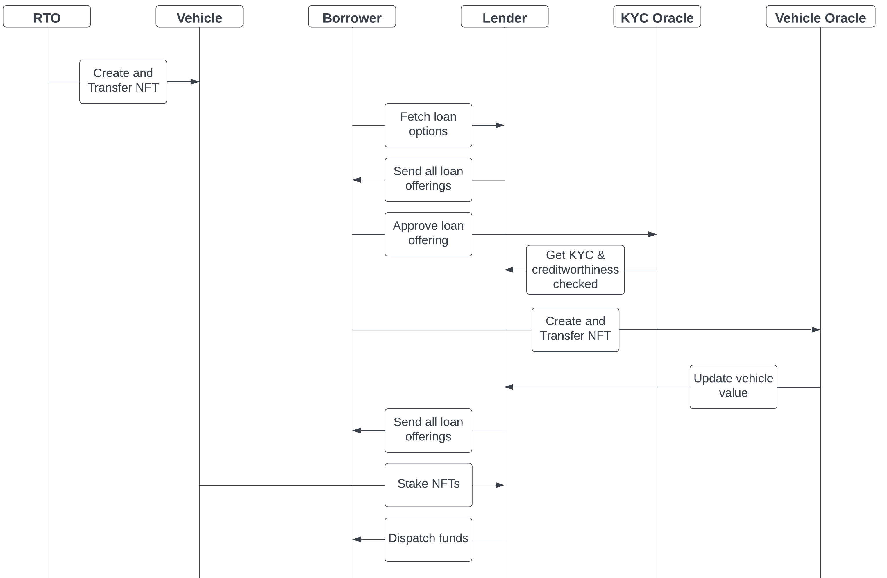
Flow Digram

Slide 16
Blockchain Platform Selection
 | Hyperledger Fabric | Ethereum | Polygon
Transparency | NO | Yes | Yes
Throughput | High | Low | High
Security | Mid | High | High
Polygon Blockchain is best suitable.

Slide 17
Technology
Frontend
Web3Js Intermediate between blockchain and frontend
ReactJs User Interface
1
Backend
NodeJS
MySQL Database
Polygon Blockchain (Solidity)
Frontend
2
Backend
Infrastructure
AWS
3
Infrastructure

Slide 18
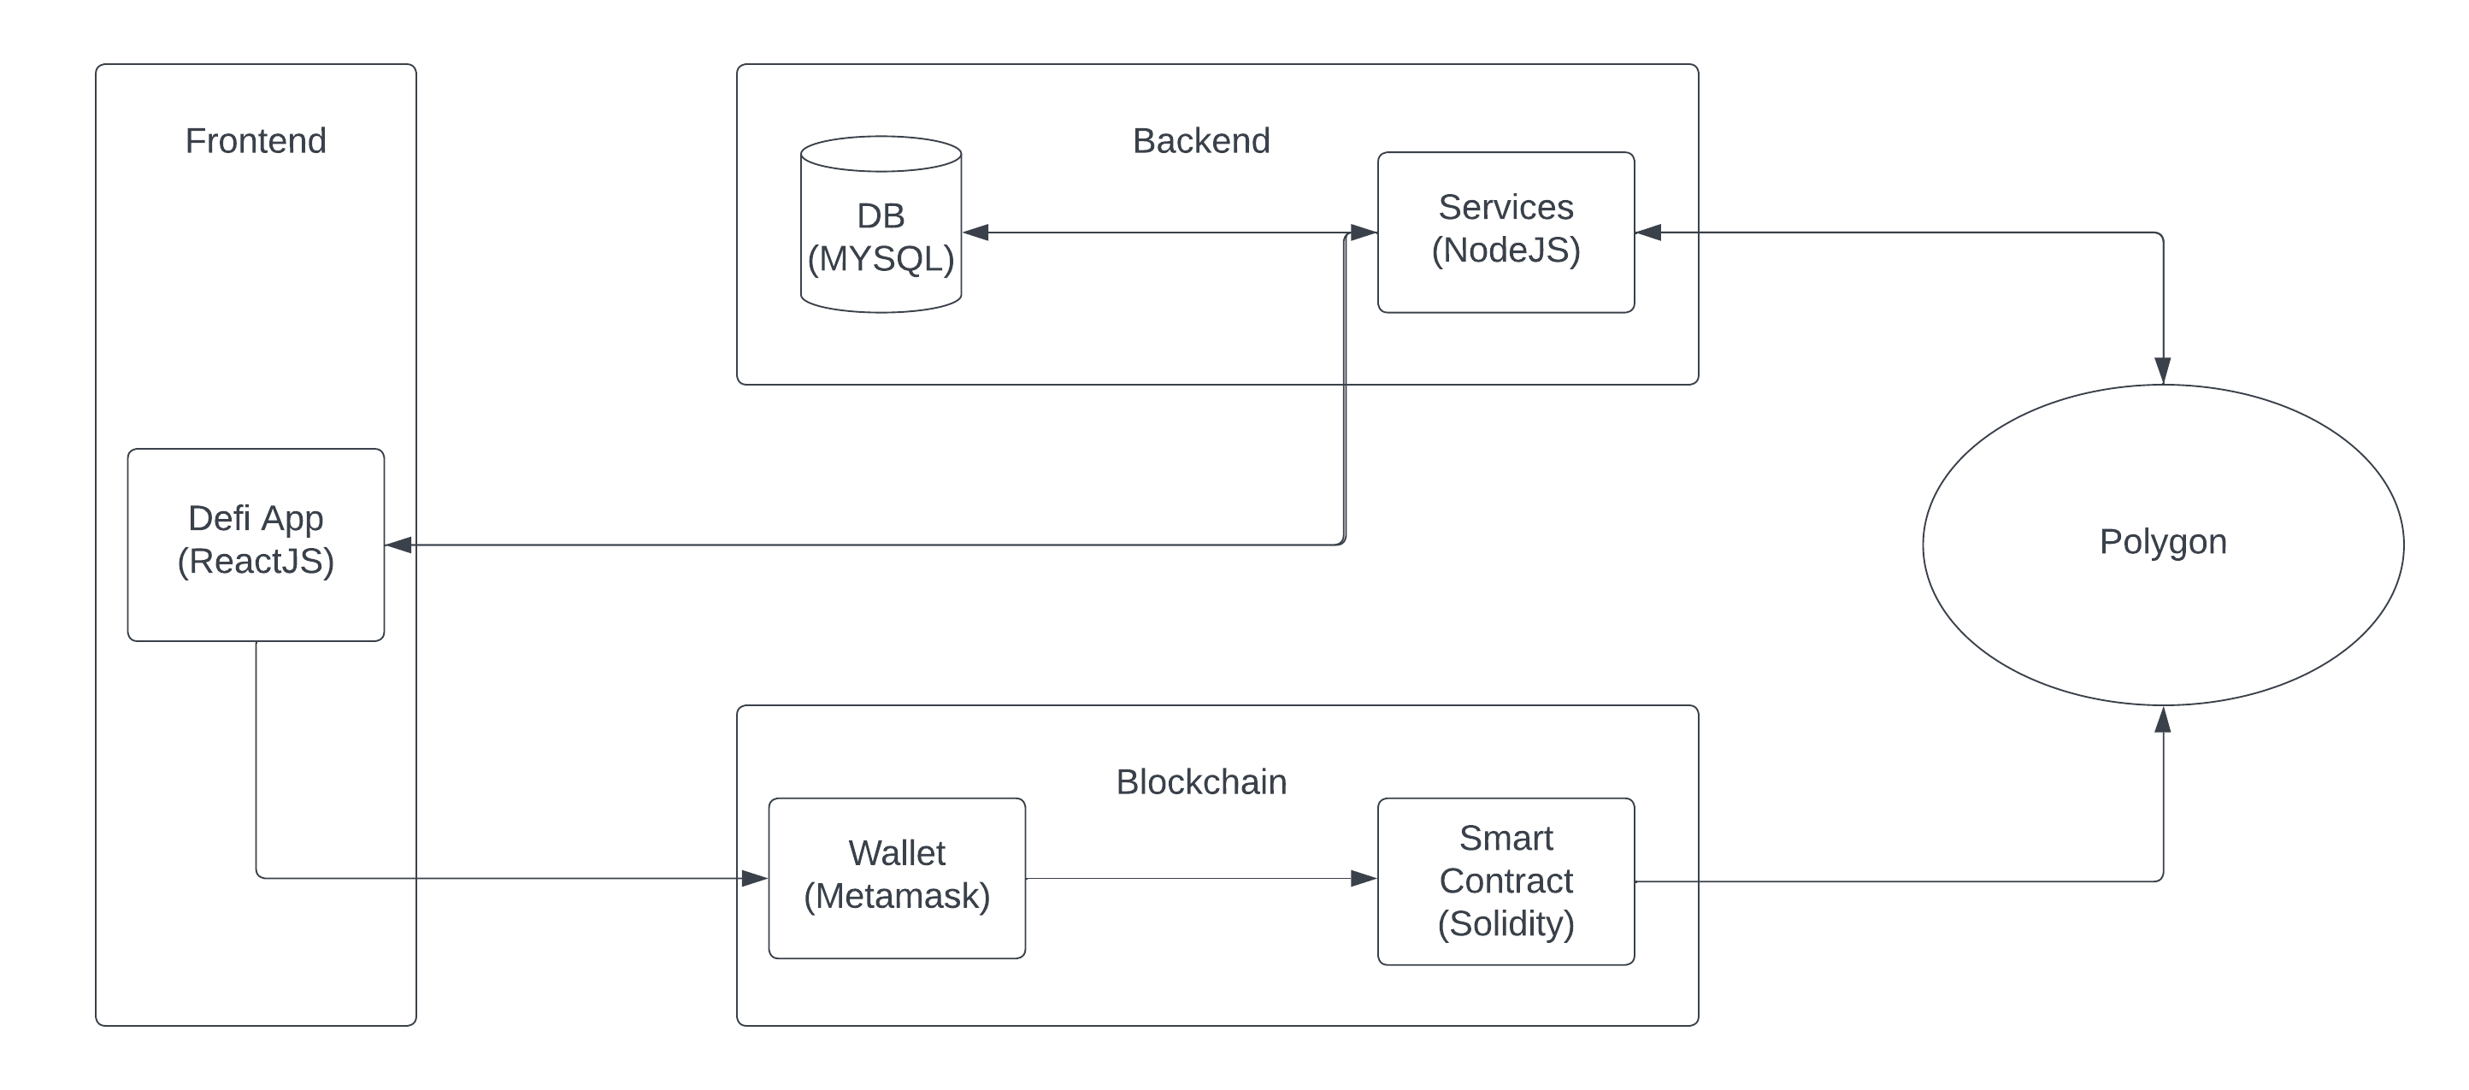
Architecture Digram

Slide 19

Conclusion
We propose the decentralized system, where borrowers, lenders, banks, RTO still exist but in decision-making. Public blockchain like Polygon gives stronger decentralization network which is tamper proof and fully transparent.

Slide 20
Thanks!
Video Link - https://drive.google.com/file/d/1DiVsU376Ui942OelwvGhd79nVP5OBgFN/view?usp=share_link
Responsibilities Doc file - https://drive.google.com/file/d/1Vx7xvTwecD9UDSrgIwvXsYhk8Ia-AfM-/view?usp=share_link

